Slide 1
JCHAt: Client-server chat application
Presented by: Ronak Bediya
Siddhant Singh

Slide 2
OBJECTIVE OF OUR PROJECT:
To make A chat application which connects 2 devices for communication with each other with the help of java networking concept java swing libraries for gui implementation and java event handling

Slide 3
Core concepts:
JAVA GUI
JAVA FILE HANDLING
JAVA MULTITHREADING
JAVA EXCEPTION HANDLING
JAVA ADVANCE NETWORKING CONCEPTS
JAVA INHERITANCE
JAVA EVENT HANDLING

Slide 4
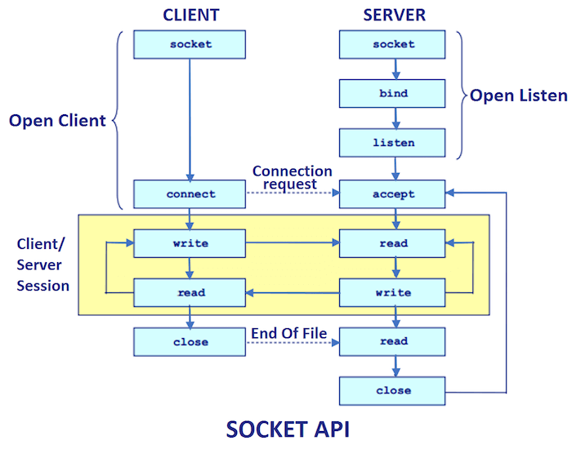
Getting started with OUR PROJECT:

Slide 5
JAVA NETWORKING CONCEPTS:
Java Socket programming is used for communication between the applications running on different JRE.
Java Socket programming can be connection-oriented or connection-less.
Socket and ServerSocket classes are used for connection-oriented socket programming and DatagramSocket and DatagramPacket classes are used for connection-less socket programming.
The client in socket programming must know two information:
IP Address of Server, and
Port number.

Slide 6
CONTINUE:
Here, we are going to make one-way client and server communication. In this application, client sends a message to the server, server reads the message and prints it.
Here, two classes are being used: Socket and ServerSocket. The Socket class is used to communicate client and server. Through this class, we can read and write message.
The ServerSocket class is used at server-side. The accept() method of ServerSocket class blocks the console until the client is connected. After the successful connection of client, it returns the instance of Socket at server-side.

Slide 7
SOME IMPORTANT TERMINOLOGIES:
Socket class
A socket is simply an endpoint for communications between the machines. The Socket class can be used to create a socket.
ServerSocket class
The ServerSocket class can be used to create a server socket. This object is used to establish communication with the clients.

Slide 8
SOME IMPORTANT TERMINOLOGIES:
host : which is the IP address of the server , in our case the server and client are both implemented on the same machine so we use the address localhost which is : 127.0.0.1
port : a port number which is the port number defined by the server in the Server.java

Slide 9
JAVA FILE HANDLING CONCEPTS:
BufferedReader in : this line means we declared an object called “ in” which is an object of the class BufferedReader. It is used to read data from the clientSocket object
PrintWriter out : this line means we declared an object called “ out ” which is an object of the class PrintWriter. It is used to write data into the clientsocket object

Slide 10
JAVA EXCEPTION HANDLING
Exceptions are termed to be runtime logical Errors.
Try and catch block which help us to recover from any exception.
printStackTrace() method: for getting the information about exception

Slide 11
Java multithreading concept:
Sender thread : it contains the code the server will use to send messages to client
Recieve thread : it contains the code the server will use to recieve messages from client
Sender thread
Now in this part, we will read data from user and we send this data to the client.
The class Thread in Java has its own default run() method which should contains the code that the thread will execute. However it can’t be executed, unless you call the method start() on that thread . Also , Since in every different thread we have a different code to implement , we use @Override annotation .

Slide 12
Continue:
Recieve thread
In this part we implement the recieve thread.
We read data that is sent from the client using the “ in” object associated to the clientSocket using the method readLine().
This method reads line by line the message sent by the client, if this method returns null that means that the client is not connected anymore. It doesn’t mean that the client didn’t send anything because the client can be connected to the server and still doesn’t send anything.

Slide 13
Java swing gui concept:
We are using gui concept for better appearance of our project
Key concepts:
1.jlabel
2.j button
3 jframe
4. action listener event
5. getcode event
6 keypressed keyreleased event

Slide 14
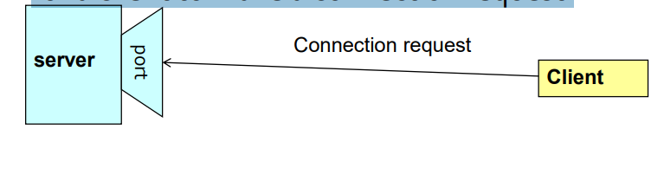
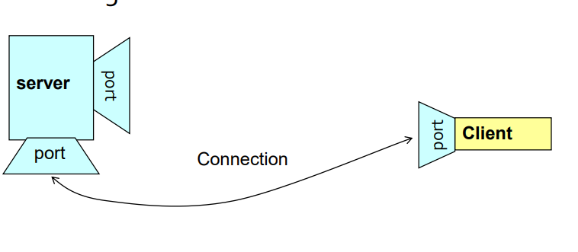
Implementing our project:
A server (program) runs on a specific computer and has a socket that is bound to a specific port. The server waits and listens to the socket for a client to make a connection request.
If everything goes well, the server accepts the connection. Upon acceptance, the server gets a new socket bounds to a different port. It needs a new socket (consequently a different port number) so that it can continue to listen to the original socket for connection requests while serving the connected client.

Slide 15
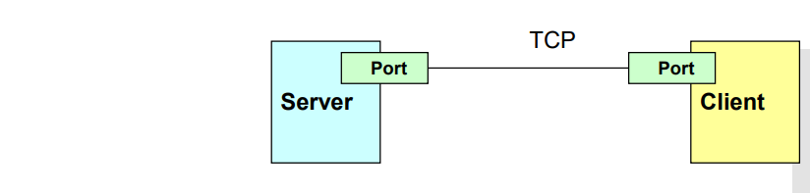
Implementing our project:
Through the classes in java.net, Java programs can use TCP or UDP to communicate over the Internet.
The URL, URLConnection, Socket, and ServerSocket classes all use TCP to communicate over the network.
The DatagramPacket, DatagramSocket, and MulticastSocket classes are for use with UDP.
TCP/IP PROTOCOL:

Slide 16
Let’s talk little bit about tcp/ip protocol:
TCP/IP stands for Transmission Control Protocol/Internet Protocol and is a suite of communication protocols used to interconnect network devices on the internet.
The entire IP suite -- a set of rules and procedures -- is commonly referred to as TCP/IP. TCP and IP are the two main protocols, though others are included in the suite. The TCP/IP protocol suite functions as an abstraction layer between internet applications and the routing and switching fabric.
TCP/IP specifies how data is exchanged over the internet by providing end-to-end communications that identify how it should be broken into packets, addressed, transmitted, routed and received at the destination. TCP/IP requires little central management and is designed to make networks reliable with the ability to recover automatically from the failure of any device on the network.

Slide 17
Tcp/ip protocol:
TCP/IP uses the client-server model of communication in which a user or machine (a client) is provided a service, like sending a webpage, by another computer (a server) in the network.
Collectively, the TCP/IP suite of protocols is classified as stateless, which means each client request is considered new because it is unrelated to previous requests. Being stateless frees up network paths so they can be used continuously.
The transport layer itself, however, is stateful. It transmits a single message, and its connection remains in place until all the packets in a message have been received and reassembled at the destination.

Slide 18
IMPLEMENTATION :
A socket is an endpoint of a two-way communication link between two programs running on the network.
A socket is bound to a port number so that the TCP layer can identify the application that data destined to be sent.
Java’s .net package provides two classes:
Socket – for implementing a client
ServerSocket – for implementing a server

Slide 19
Implementation:
. A server socket waits for requests to come in over the network. It performs some operation based on that request, and then possibly returns a result to the requester.
A server socket is technically not a socket: when a client connects to a server socket, a TCP connection is made, and a (normal) socket is created for each end point.

Slide 20
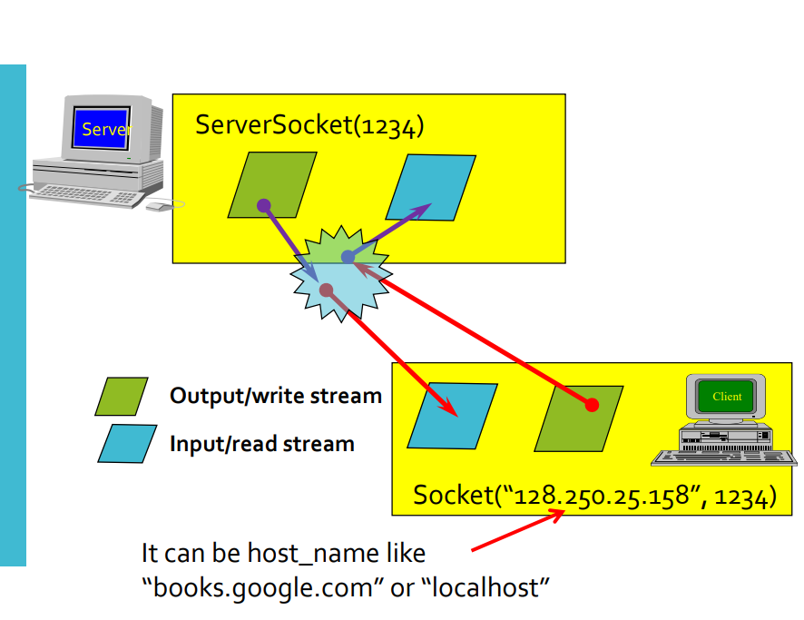
implementation:

Slide 21
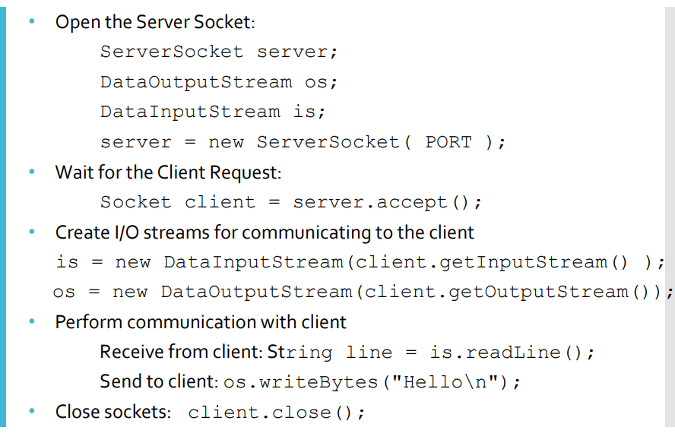
Steps to create a server class:

Slide 22
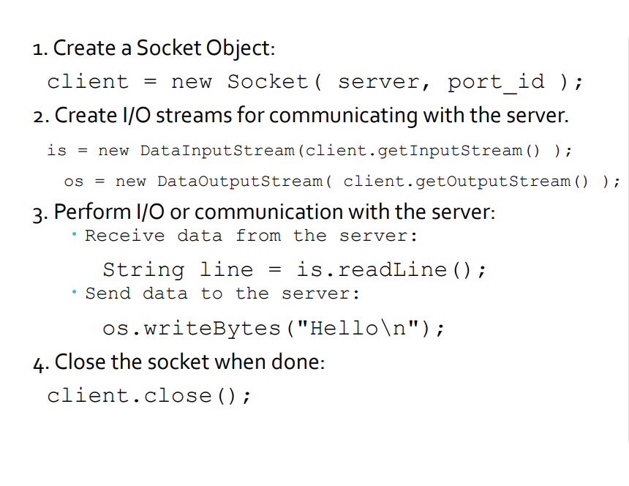
Steps to create client:

Slide 23
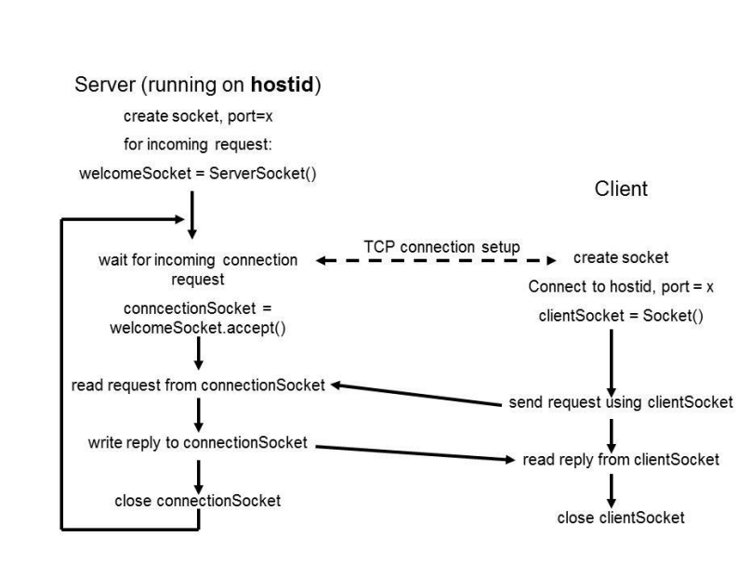
Inter communication between client and server via tcp:

Slide 24
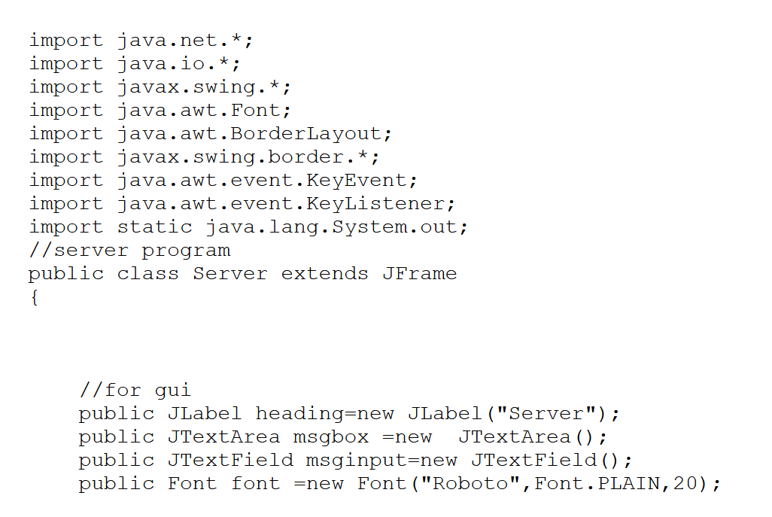
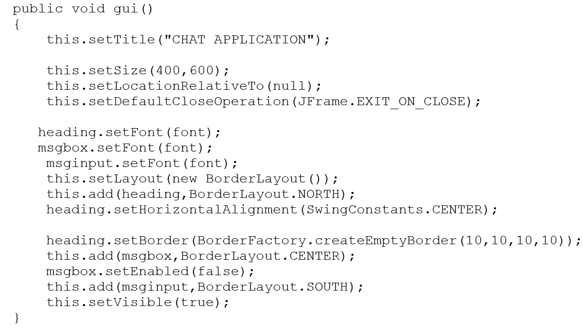
Source code of server.java

Slide 25
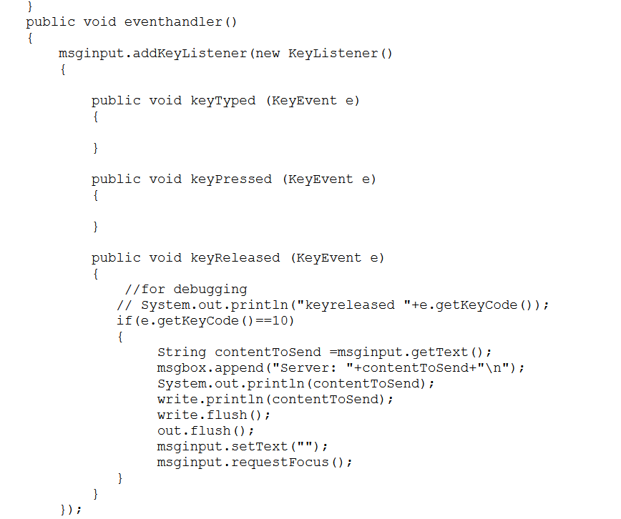
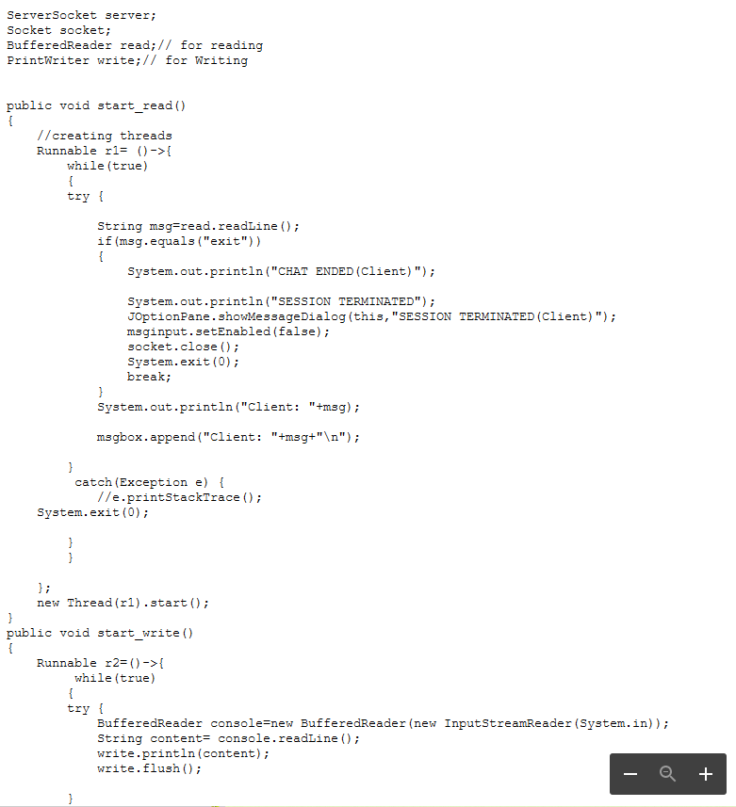
Source code of server.java

Slide 26
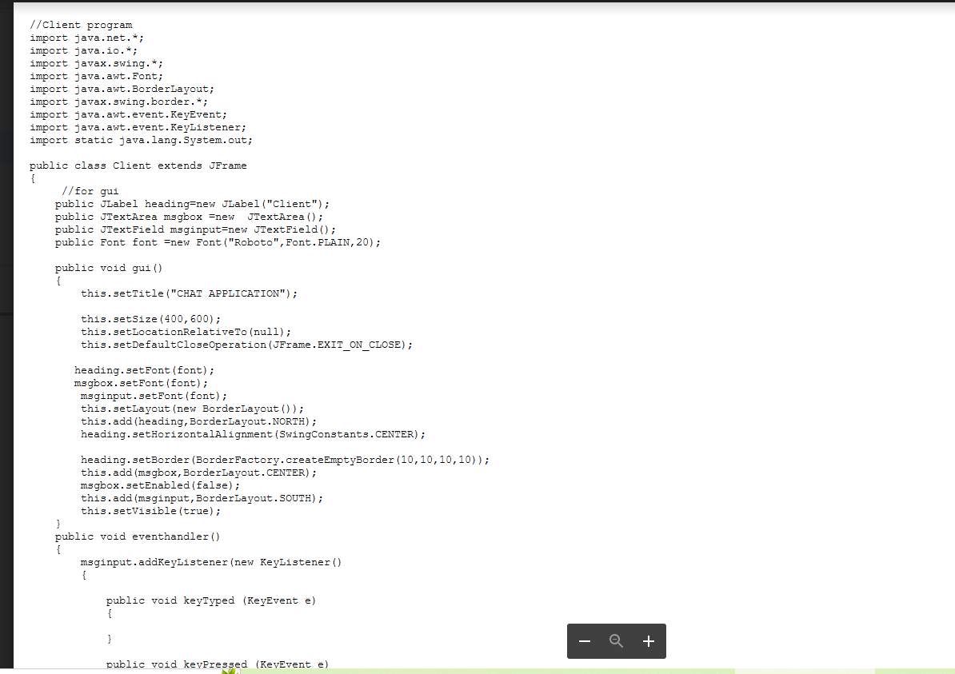
Source code for client.java

Slide 27
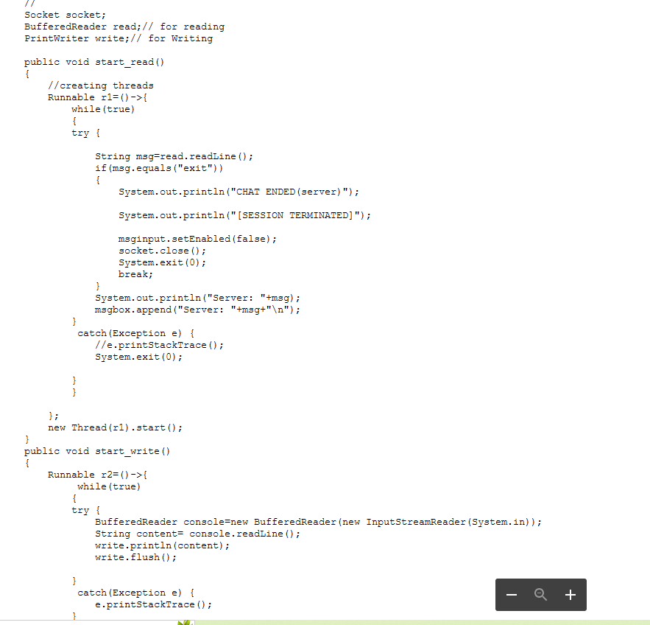
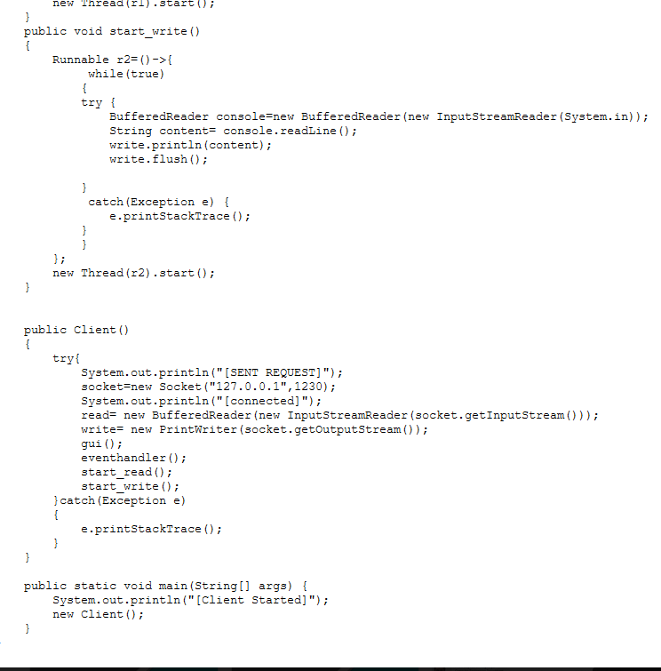
Source code for client.java

Slide 28


